Slide 1
Scaling stream processing with Kafka and Spark
Emanuele Della Valle
emanuele.dellavalle@polimi.it

Slide 2
Position of this class in the course

Slide 3

Taming
Continuous numerous flows that can turn into a torrent with Complex Event Processing
Covered in the lectures on EPL and Esper

Slide 4


Taming
Myriads of tiny flows that you can collect with Event-based Systems
Image by Pexels from Pixabay

Slide 5


Taming
Continuous massive flows than you cannot stop with Data Stream Mng. Systems

Slide 6
Throughput Latency Data/Message
Few important concepts

Slide 7
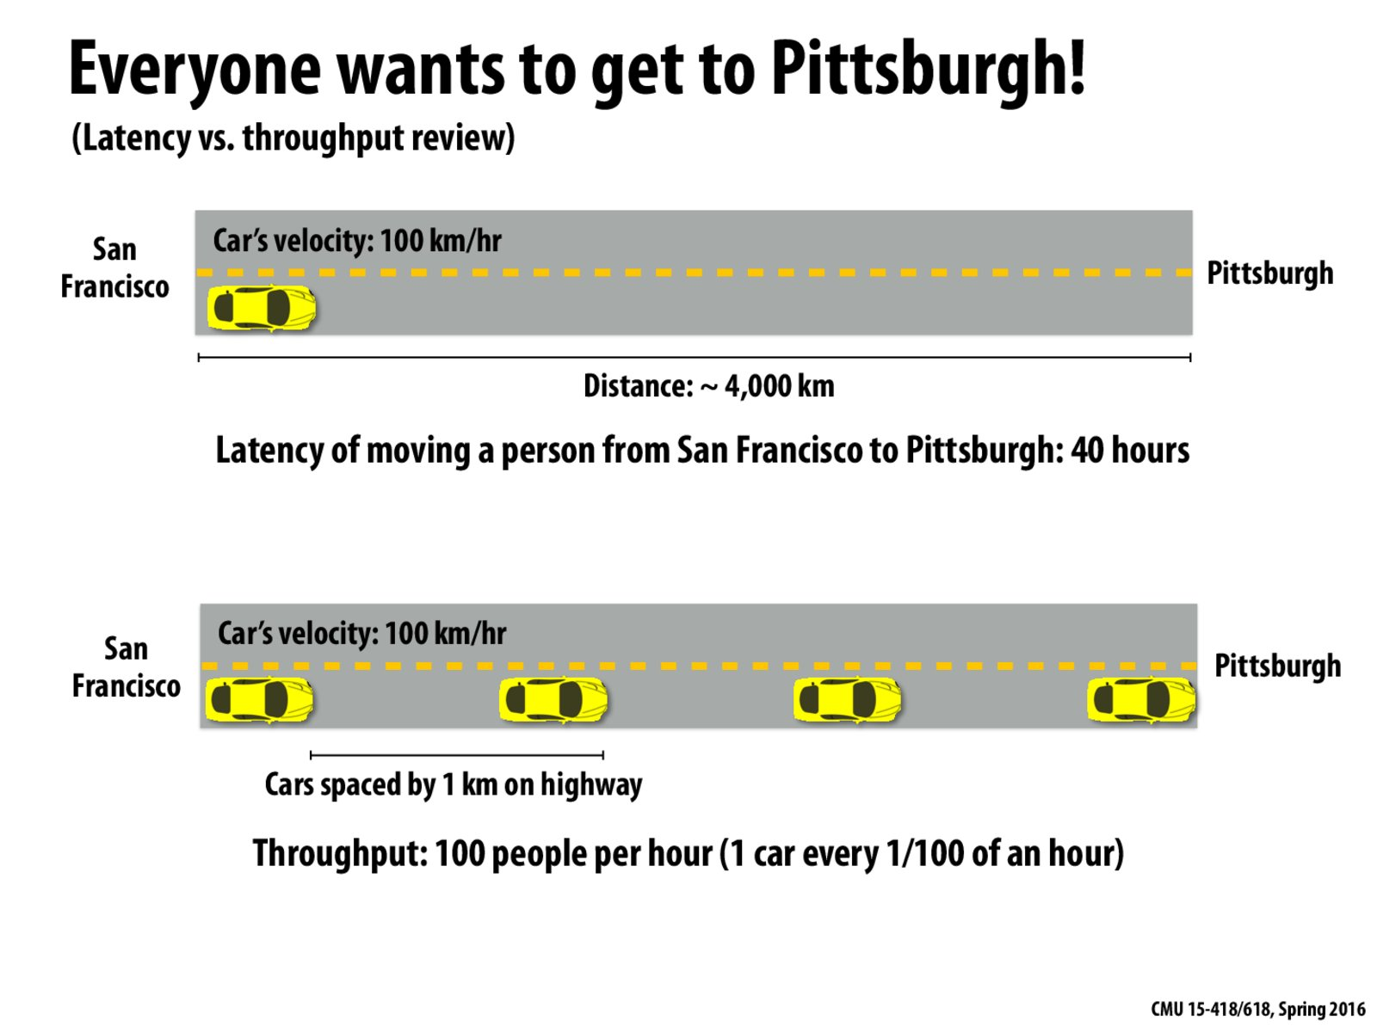

Slide 8
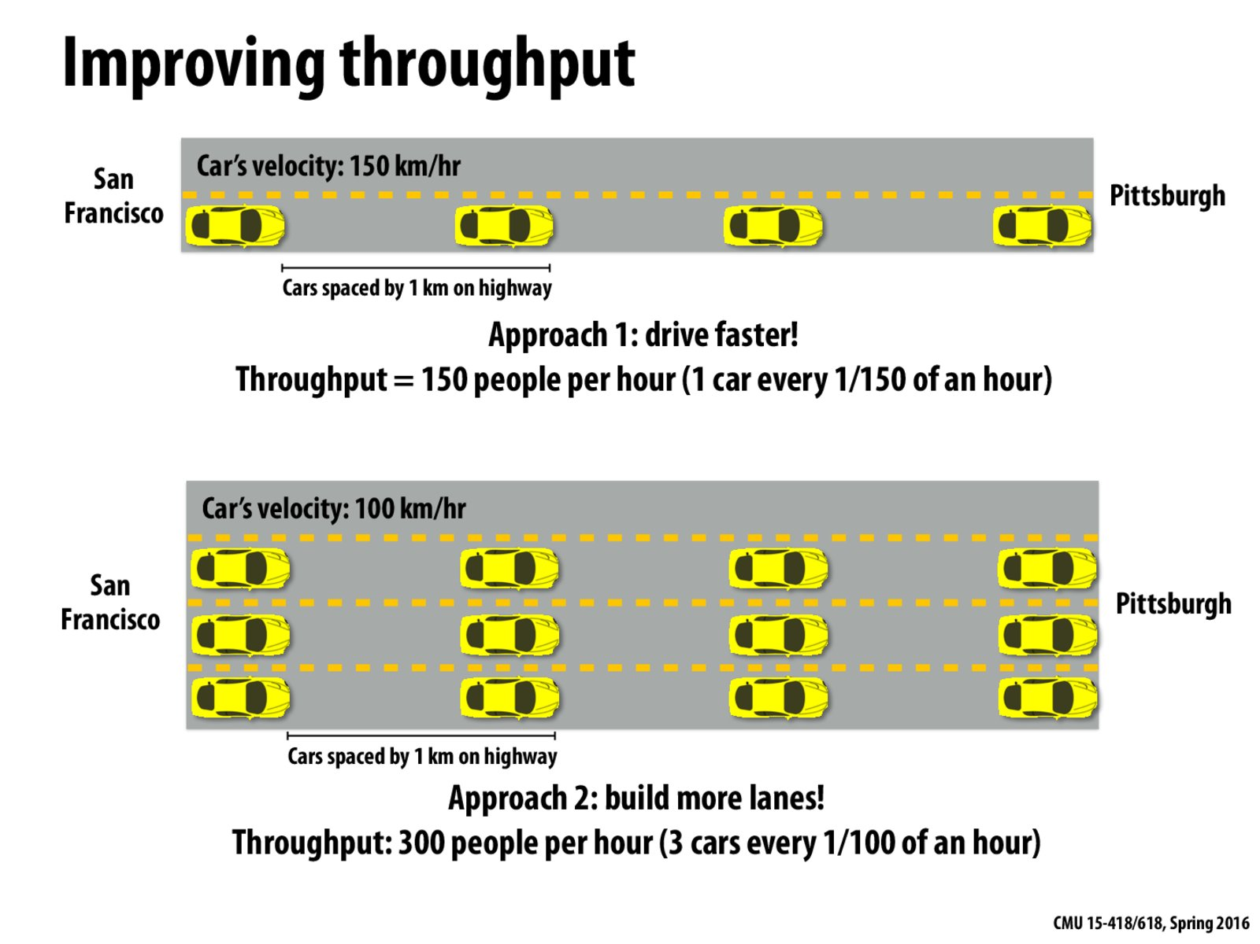

Slide 9
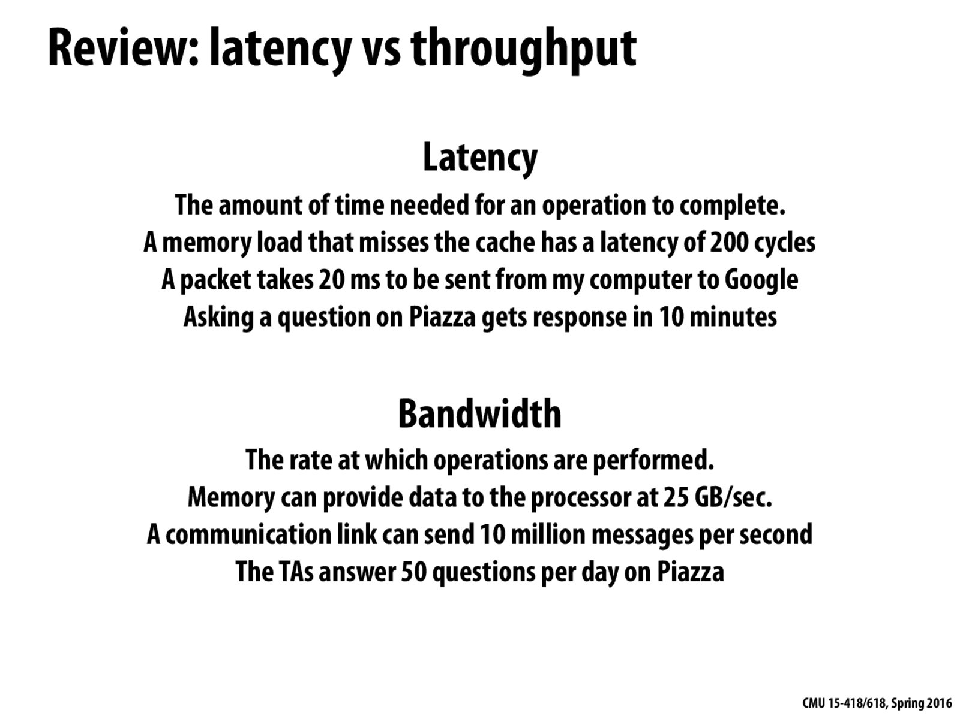

Slide 10
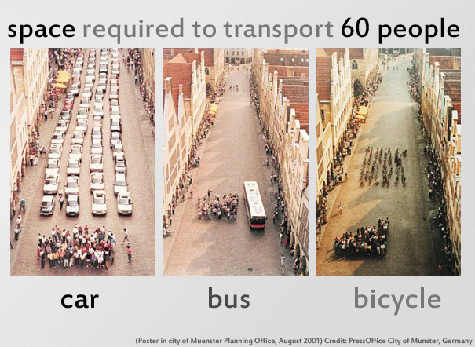

Slide 11
Data/Message matters!
Fixed the size of a message (i.e., the space between two cars)
The more people fit in the car, the higher the throughput
The larger the data points per message, the higher the throughput
Compression and binary encoding are the typical ways to increase data per message

Slide 12
Taming
Myriads of tiny flows that you can collect with Event-based Systems
Image by Pexels from Pixabay

Slide 13
Kafka History
In 2010, it was created at LinkedIn to
Simplifying data pipelines
Processing streaming data for batch and real-time analytics
In 2012, it became a top-level Apache project
Now, it is now at the core of LinkedIn’s architecture
Performs extremely well at very large scale
Produces over 2 trillion messages per day
and it is in use at many organizations
Twitter, Netflix, Goldman Sachs, Hotels.com, IBM, Spotify, Uber, Square, Cisco...

Slide 14
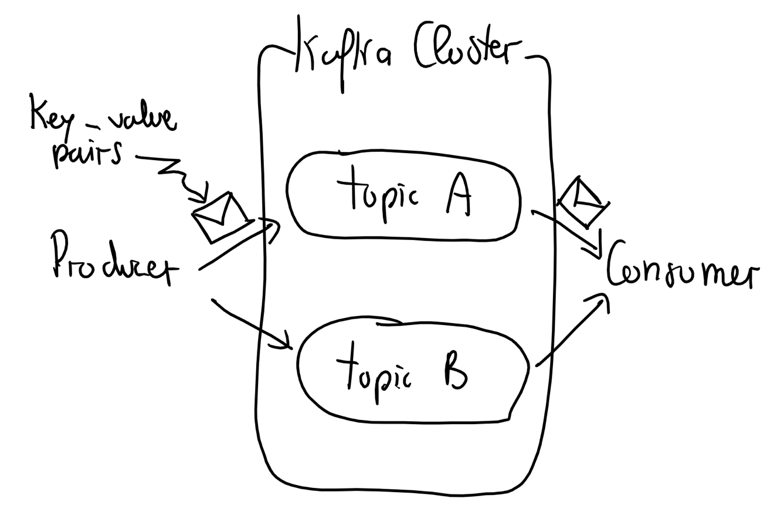
A Conceptual View of Kafka
Producers send messages on topics
Consumers read messages from topics
Messages are key-value pairs
Topics are streams of messages
Kafka cluster manages topics

Slide 15
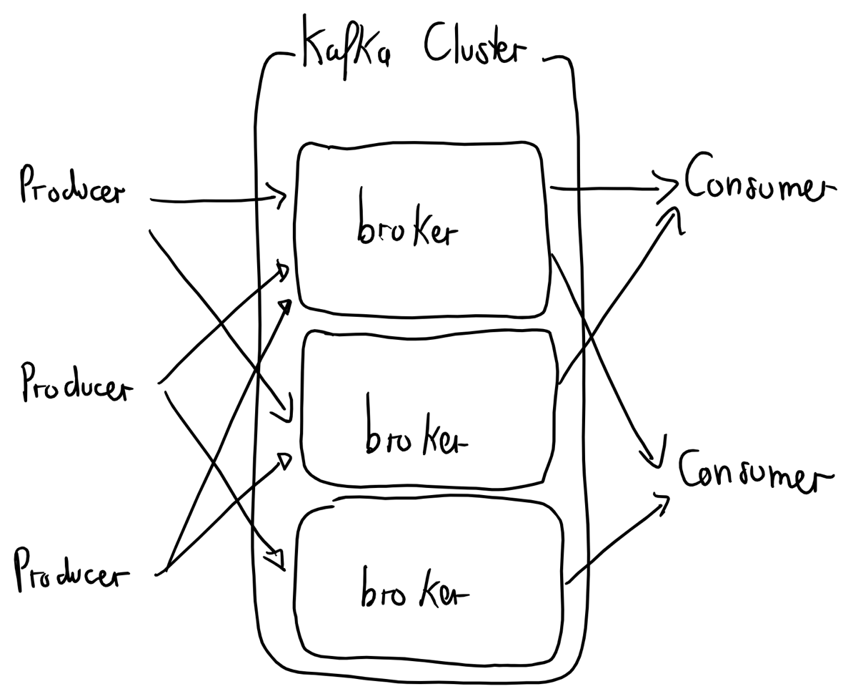
A System View of Kafka
Brokers are the main storage and messaging components of the Kafka cluster

Slide 16
Notice the similarity

Slide 17
More on brokers
Brokers receive and store messages when they are sent by the Producers
A production Kafka cluster will have three or more Brokers
Each can handle hundreds of thousands, or millions, of messages per second
Typically, a Broker manages multiple Partitions

Slide 18
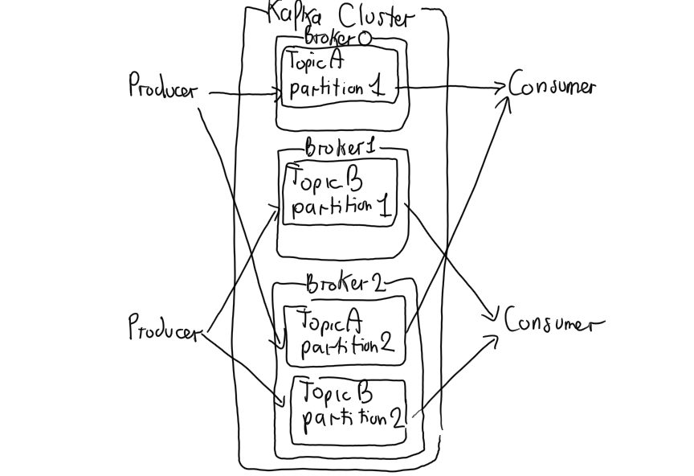
Reconciling the two views
Topics are partitioned across brokers
Producers shard messages over the partitions of a certain topic
Typically, the message key determines which partition a message is assigned to

Slide 19
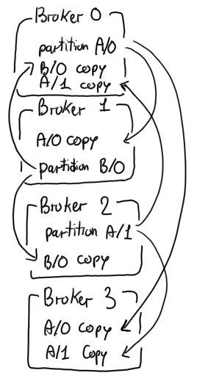
Fault Tolerance via a Replicated Log
Kafka maintains replicas of each partition on other Brokers in the cluster
Number of replicas is configurable
One Broker is the leader for that Partition
All writes and reads go to and from the leader
Other Brokers are followers
Replication provides fault tolerance in case a Broker goes down

Slide 20
Producers, fault tolerance and durability
Producers can control durability by requiring the leader a number of acknowledgments the before considering the request complete.
acks=0 Producer will not wait for any acknowledgment from the broker
acks=1 Producer will wait until the leader has written the record to its local log
acks=all Producer will wait until all insync replicas have acknowledged receipt of the record

Slide 21
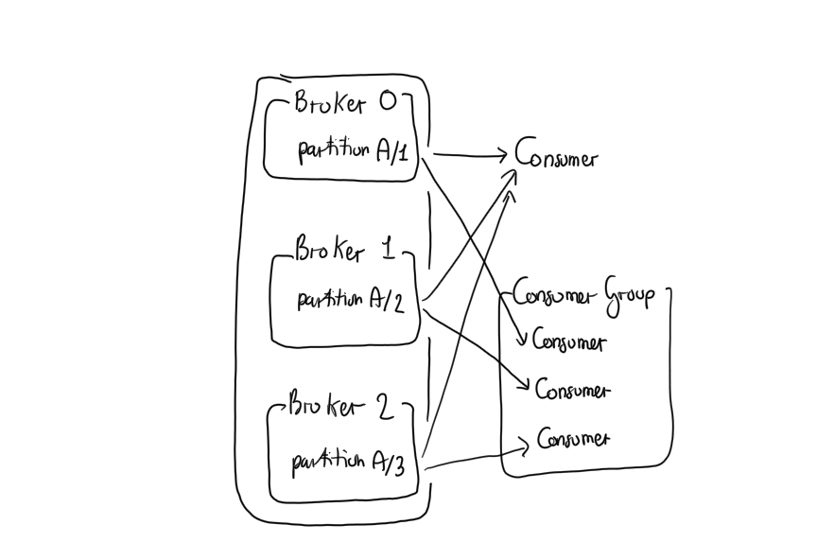
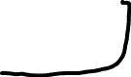
Topic partitioning invites distributed consumption
Different Consumers can read data from the same Topic
By default, each Consumer will receive all the messages in the Topic
Multiple Consumers can be combined into a Consumer Group
Consumer Groups provide scaling capabilities
Each Consumer is assigned a subset of Partitions for consumption

Slide 22
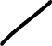
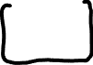

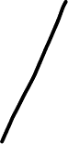

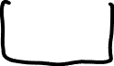


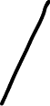

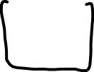
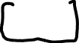
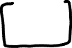
Consumer Group and scalability

Slide 23
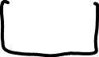
Once again, notice the similarity

Slide 24
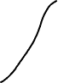


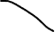
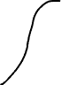
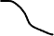
Consumer Group and fault tollerance

Slide 25
Quiz
Provide the correct relationship — 1:1, 1:N, N:1, or N:N –
Broker to Partition — ?
Key to Partition — ?
Producer to Topic — ?
Consumer Group to Topic — ?
Consumer (in a Consumer Group) to Partition — ?
Notes:
– Broker to Partition — N:N – Key to Partition — N:1 – Producer to Topic — N:N
– Consumer Group to Topic — N:N – Consumer (in a Consumer Group) to Partition — 1:N

Slide 26
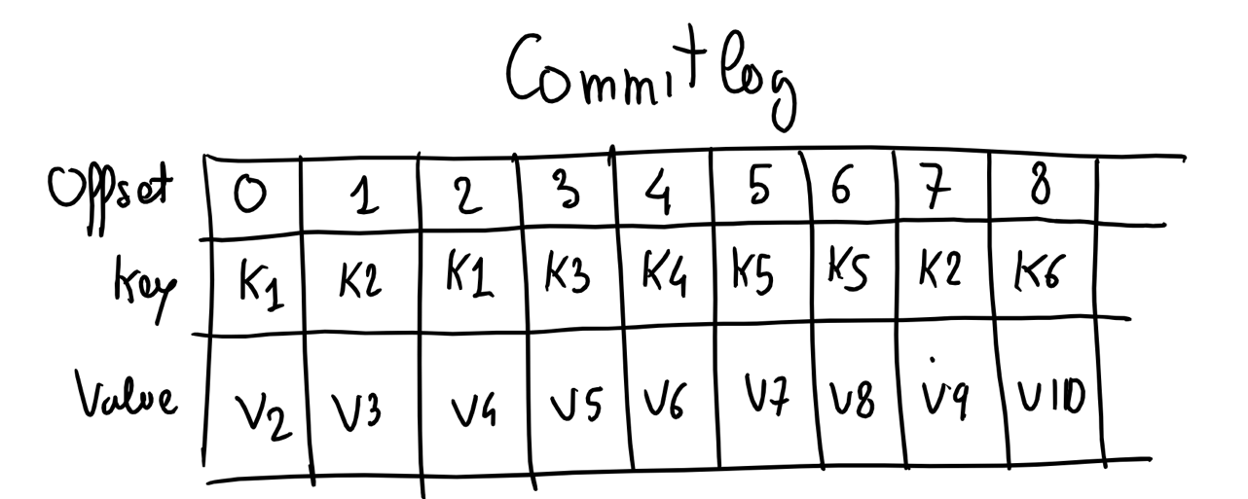
A Physical View of topic partition
Each Partition is stored on the Broker’s disk as one or more log files
Each message in the log is identified by its offset number

Slide 27
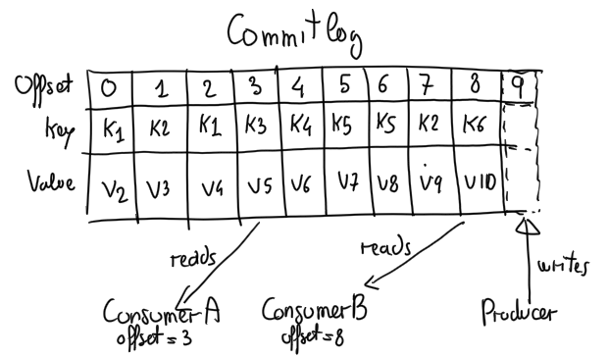
A Physical View of topic partition (cont.)
Messages are always appended
Consumers can consume from different offset
Brokers are single thread to guarantee consistency

Slide 28
Log Retention
Duration default: messages will be retained for seven days
Duration is configurable per Broker by setting
a time period
a size limit
Topic can override a Broker’s retention policy
When cleaning up a log
the default policy is delete
An alternate policy is compact

Slide 29
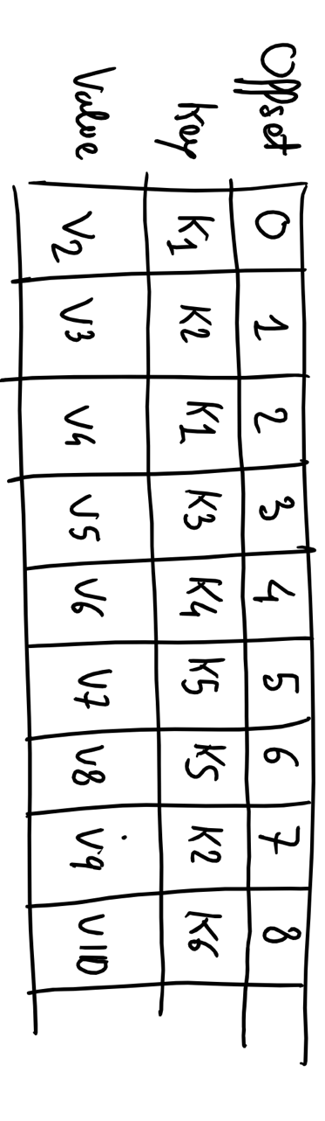
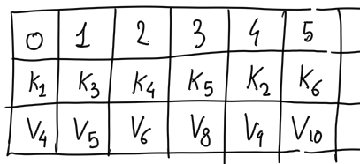
Log compaction
A compacted log retains at least the last known message value for each key within the Partition
Before compaction | After compaction

Slide 30
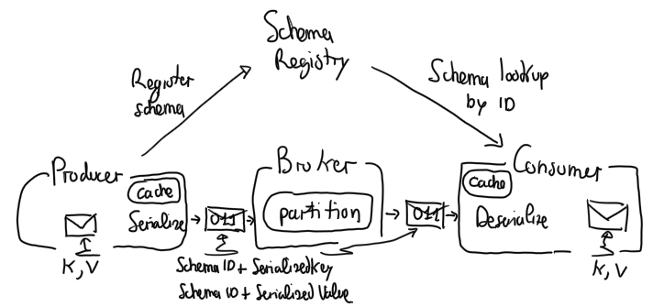
Avro and Schema Registry at work

Slide 31

Avro
Avro is an Apache open source project
Provides data serialization into a binary format
so stores data efficiently
Data is defined with a self-describing schema allowing for
code generation for serializers and de-serializers in multiple languages
type checking at write time

Slide 32
Schema Registry
Sending the Avro schema with each message would be inefficient
The Schema Registry
is a Confluent component
provides centralized management of schemas
At registration time each schema is given an ID
The mapping schema/ID is stored in a special Kafka topic

Slide 33
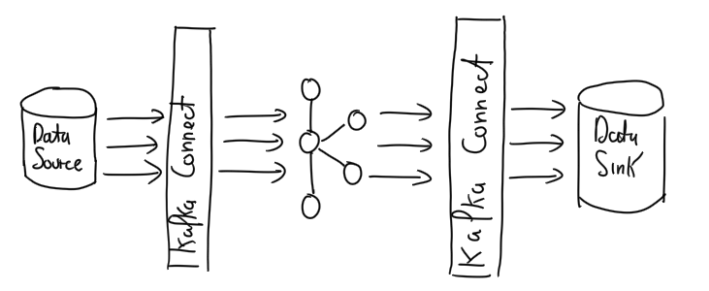
Kafka Connect
It is an open source framework for streaming data between Apache Kafka and other data systems
It is simple, scalable, and reliable

Slide 34
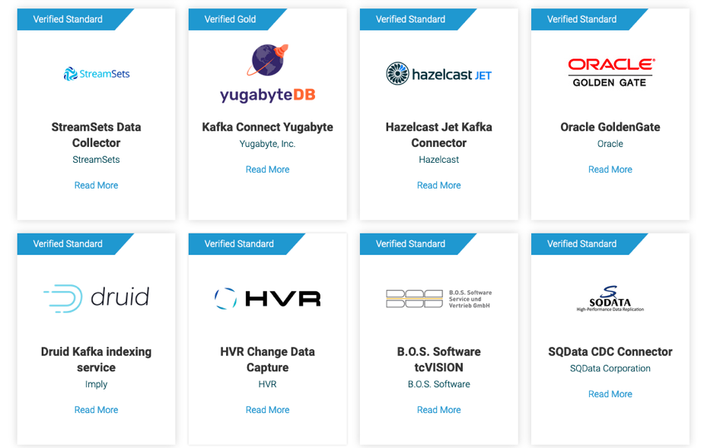
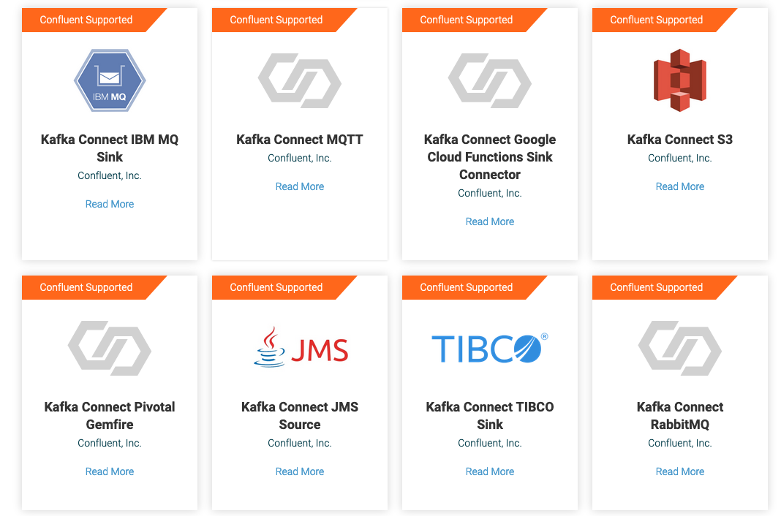
Off-The-Shelf Connectors
https://www.confluent.io/product/connectors/

Slide 35
Taming
Continuous massive flows than you cannot stop with Data Stream Mng. Systems

Slide 36

Apache
Unified analytics engine for big data processing, with built-in modules for streaming, SQL, machine learning and graph processing

Slide 37

vs.
Apache hadoop is disk-centric
Apache Spark is RAM-centric

Slide 38
The architecture of

Slide 39
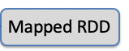

RDD
Definition
Resilient: Fault-tolerant
Distributed: Computed across multiple nodes
Dataset: Collection of partitioned data
Characteristics
Immutable once constructed
Track lineage information
Logical view: single dataset
Physical view: 1 or more partitions
RDD

Slide 40
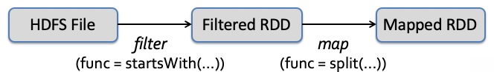
Transformations - logical view
RDD are immutable, transformations create new RDD
msgs = (textFile.filter(lambda s: s.startsWith(“ERROR”))
.map(lambda s: s.split(“\t”)[2]))
lineage

Slide 41
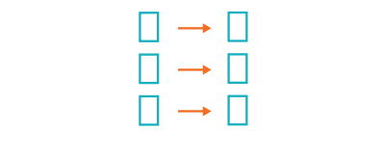
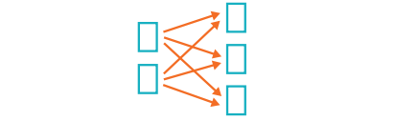
Transformations – physical view
Narrow Transformations
The data required to compute the records in a single partition reside in at most one partition of the parent RDD
map()
filter()
…
Wide Transformations (shuffles)
The data required to compute the records in a single partition may reside in many partitions of the parent RDD
groupBy(..).sum()
distinct()
…

Slide 42
Actions – logical view
Actions either return a result or write to disc
For example:
The number of records in the case of count()
An array of objects in the case of collect() or take(n)

Slide 43

Actions – system view
Base RDD
lines = sc.textFile(“hdfs://...”)
errors = lines.filter(lambda s: s.startswith(“ERROR”))
messages = errors.map(lambda s: s.split(“\t”)[2])
results
Worker
messages.filter(lambda s: “mysql” in s).count()
tasks
Block 1
Transformed RDD
Action
Driver
Worker
Worker
Block 2
Block 3
Notes:
Add “variables” to the “functions” in functional programming

Slide 44
Caching (where the magic is!)
lines = spark.textFile(“hdfs://...”)
errors = lines.filter(lambda s: s.startswith(“ERROR”))
messages = errors.map(lambda s: s.split(“\t”)[2])
messages.cache()
Cache 1
results
Worker
messages.filter(lambda s: “mysql” in s).count()
tasks
Block 1
Driver
messages.filter(lambda s: “php” in s).count()
. . .
Cache 2
IN PRACTICE
Full-text search of Wikipedia
60GB on 20 EC2 machine
0.5 sec vs. 20s for on-disk
Worker
Cache 3
Worker
Block 2
Block 3
Notes:
Add “variables” to the “functions” in functional programming

Slide 45
Laziness By Design
Fundamental to Apache Spark are the notions that
Transformations are LAZY
Actions are EAGER
NOTE: We saw this play out in the previous slide when we run multiple transformations back-to-back, and no job was triggered until the first action was requested

Slide 46
DataFrame
Definition
Immutable Data with named columns
Built on RDDs
Characteristics
User-friendly API
Uniform APIs across languages (Scala, Java, Python, R, and SQL)
Improved performance via optimizations (Tungsten and Catalyst)

Slide 47
DataFrame code snippet
An Apache Spark code snippet using SQL and DataFrames to query and join different data sources
# Read a CSV
userDF = spark.read.csv(" … /userData.csv")
# ... or Use DataFrame APIs and register a temp view
middleageSmokers = userDF.filter(col("smoker")=="Y").filter(col("age")>40)
middleageSmokers.createOrReplaceTempView("middleageSmokers")
# ... read a CSV and register a temp view
spark.read.json(" … /part-00000.json.gz").createOrReplaceTempView("iot_stream")
# ... execute SQL query or ...
spark.sql("SELECT avg(calories_burnt) FROM iot_stream JOIN middleageSmokers ON …")

Slide 48
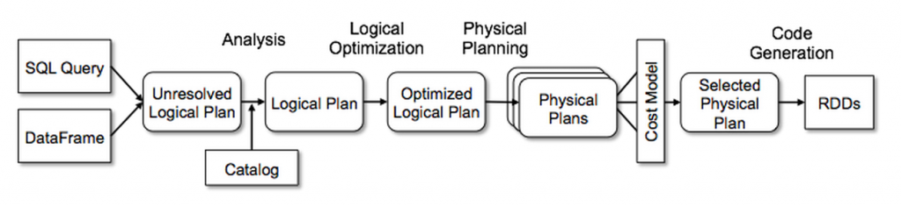
Under the Hood: Catalyst
Generates optimal RDD code from the user request

Slide 49
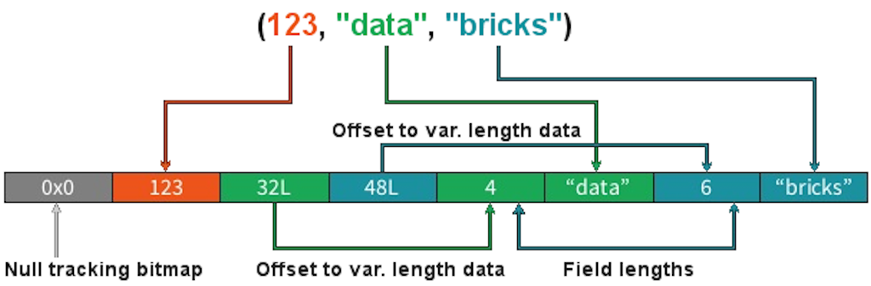
Under the Hood: Tungsten Binary Format
Off-heap, compact and efficient in-memory storage row format

Slide 50
Spark at work – Jobs, Stages and Tasks
The DAG Scheduler is the scheduling layer of Spark
It transforms a logical execution plan into a physical one (a Job) considering data locality and partitioning (to avoid shuffles)
Each Job is a DAG of Stages which are broken down into Tasks
A:
B:
F:
Stage 1
groupBy
C:
D:
E:
join
Stage 2
map
filter
Stage 3
= RDD
= cached partition

Slide 51
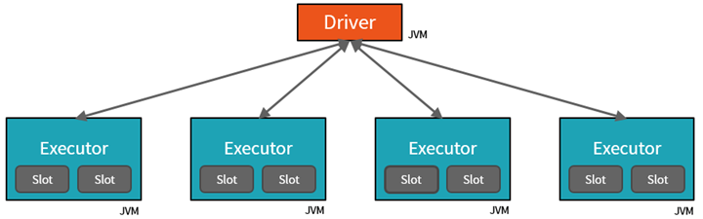
Spark at work - components
A Spark cluster includes
One Driver running the user application
Multiple Executors (typically, one instance per node) with multiple Slots (typically, one per core/CPU)

Slide 52
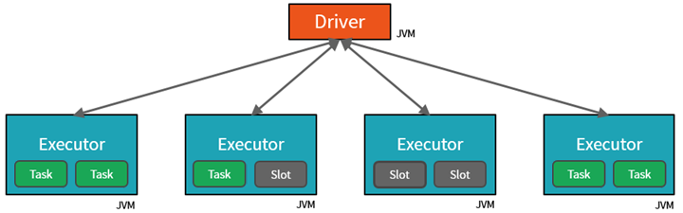
Spark at work – runtime view
The Driver assigns Tasks to Executors’ Slots for parallel execution
The Driver also makes sure that all tasks of a Stage are executed before starting any task of the next stage

Slide 53
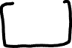
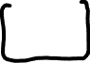
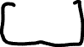


Connecting Spark to kafka

Slide 54
Scaling stream processing with Kafka and Spark
Emanuele Della Valle
emanuele.dellavalle@polimi.it

